Slide 1
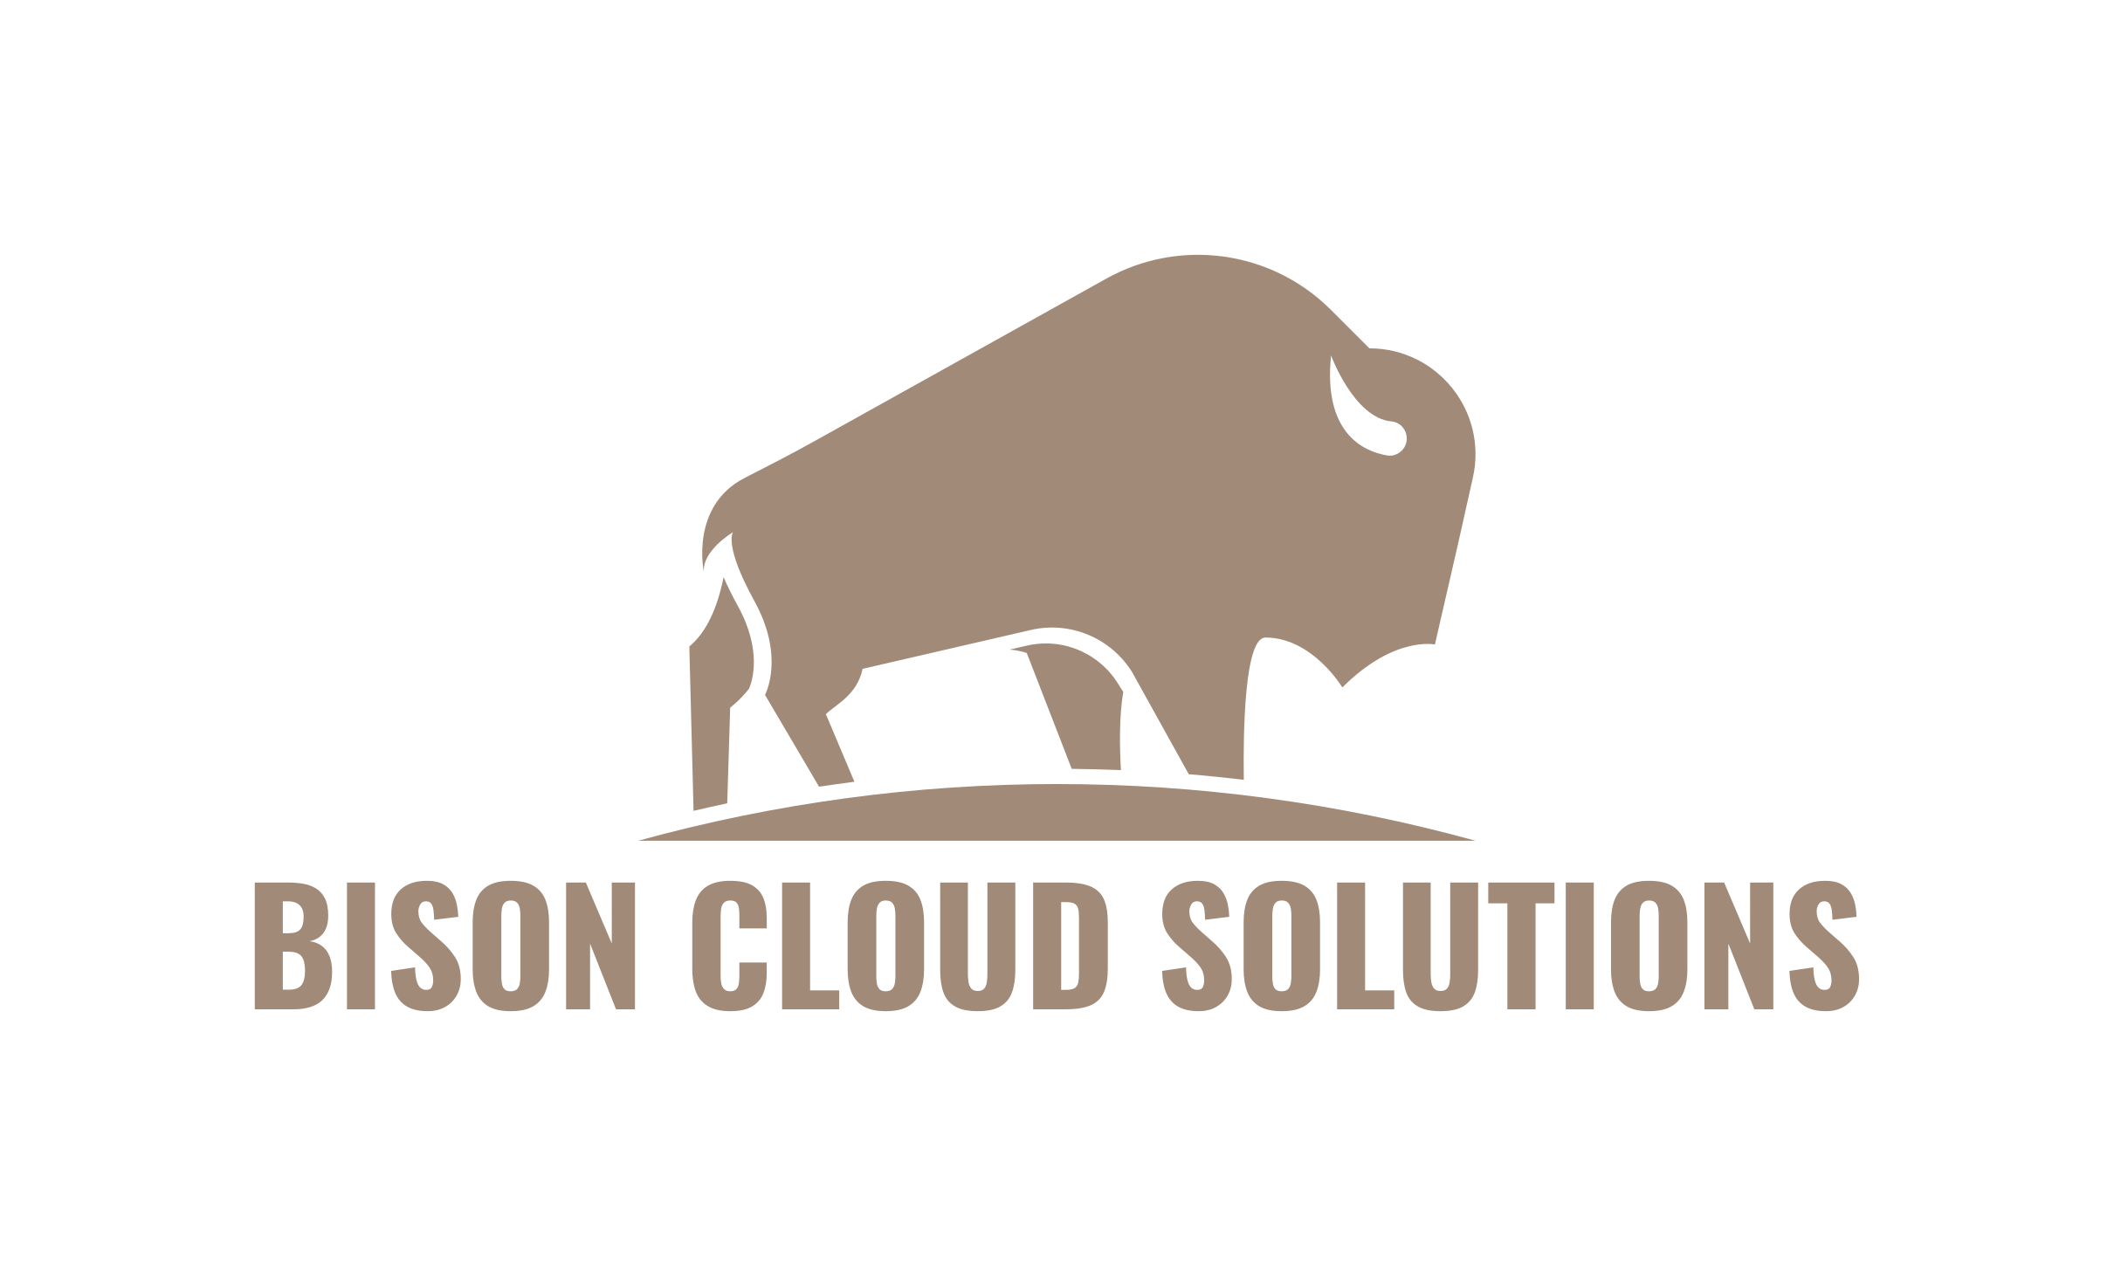
Controlling Cloud Costs

Slide 2

Agenda
Introduction
Think Cloud
Security Costs
Cost Savings
Infrastructure as Code (IaC)

Slide 3
Introduction
Presenter: Jacob Charles
Founder of Bison Cloud Solutions
Cloud DevSecOps Consultant for KBR Space and Mission Solutions (EROS Contract)
Prior companies worked at were Ameritas, gWorks, and UBT
Company: Bison Cloud Solutions
Full service managed service provider, cloud first.
Risk Insurance Compliance
Consulting Services
Slides: https://github.com/bisoncloudsolutions/controlling-cloud-costs

Slide 4
Think Cloud
Pay as you go
Monthly bill by usage such as storage and compute
By default, you will typically not be notified of unused resources
Services may contain multiple dimensions of costs. For example, a Lambda or Function may incur networking costs in addition to compute time.
System Architects, application designers, infrastructure engineers must understand cloud costs

Slide 5
Think Cloud
Use native cloud services vs traditional services (instances & dedicated servers)
Only run compute when it's needed, included instances (shut down when not in use)
Utilize tiered storage (Frequent vs Infrequent access)
Resources are typically ephemeral, especially IP addresses within your address space.
Resources such as instance images, containers, running lambdas, database versions, last access date on a file in standard storage, should not have birthdays.

Slide 6
Security – Overhead Costs
Cloud costs is a security concern
Use cloud aware or cloud native security tools
Traditional on-premise security tools do not handle ephemeral environments
Do not use IP based security tools (Tools that identify machines by IP)
Traditional on-premise security tools create significant overhead when tracking down issues as they become a "moving target"
Intentionally determine what gets logged, and for how long. Create log caps and estimate log sizing.
Storage lifecycle policies
What services do you want logged?

Slide 7
Security – Cloud Native Tools
AWS
AWS Inspector – Vulnerbility assessment, continuous.
AWS SecurityHub – Security dashboarding and aggregation
AWS WAF with Security Groups – Firewall and host-based firewall rules
AWS Guard Duty – Intelligent Threat Detection
Azure
Defender with Advanced Threat Detection
WAF

Slide 8
Cost Savings
AWS Trusted Advisor, Azure Advisor, Google Recommender
Provides cost savings insights, for example over/under utilizations for instance sizes
For larger organizations, tools like CloudChkr can provide detailed cost savings reports
AWS/Azure Cost Savings plans and reserved instances
Provide discounts on services that will be 1 or 3 year commitments at a certain usage level.

Slide 9
Infrastructure as Code (IaC)
Infrastructure as Code (IAC) is defining your cloud infrastructure through code instead of manually deploying components through the console or even the command line.
To control costs at scale, know exactly what is an authorized vs unauthorized resource.
Approve infrastructure through a process (change control, pull requests, etc...)
Do not allow unauthorized infrastructure.
Sandbox or Development environments may introduce concepts such as automated cleanups after X number of days not being in IaC

Slide 10
Authorized VS Unauthorized Resources
Authorized Resources
Approved by a process
Controlled by IaC
Unauthorized Resources
Deployed outside of IaC
Should be deleted when detected by AWS Config or Azure Application Change Analysis

Slide 11
Lock Down the Cloud
Wild West Environments are the most expensive environments
Only allow creation of resources through IaC,
Specific groups of people may be restricted to certain types of resources (Developers and Infrastructure groups).
Prevent configuration drift
Do not allow modification of resources from IaC tooling outside of the code base.
Auto correct configuration drift if it happens
Role based resource creation
Who can deploy what resources and at what size?

Slide 12
IaC Recommendation
Terraform
https://www.terraform.io/
Multi-cloud, and has many other IaC providers
Built-in config drift remediation/detection

Slide 13
Quick Story...
...About a company that intentionally deleted all of its cloud infrastructure.

Slide 14
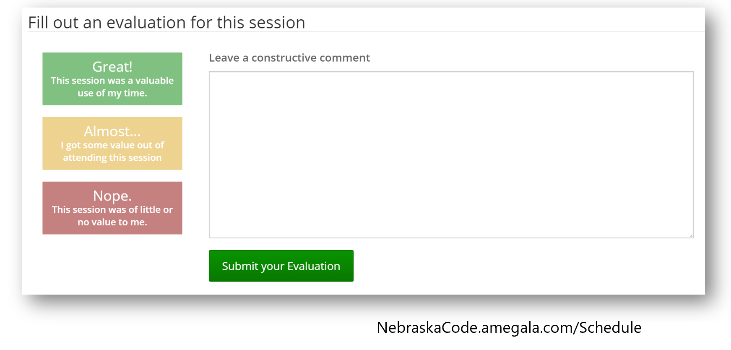
Questions?
jacob.charles@bisoncloudsolutions.com
https://bisoncloudsolutions.com
https://www.linkedin.com/in/jacobcharles300/

